Slide 1
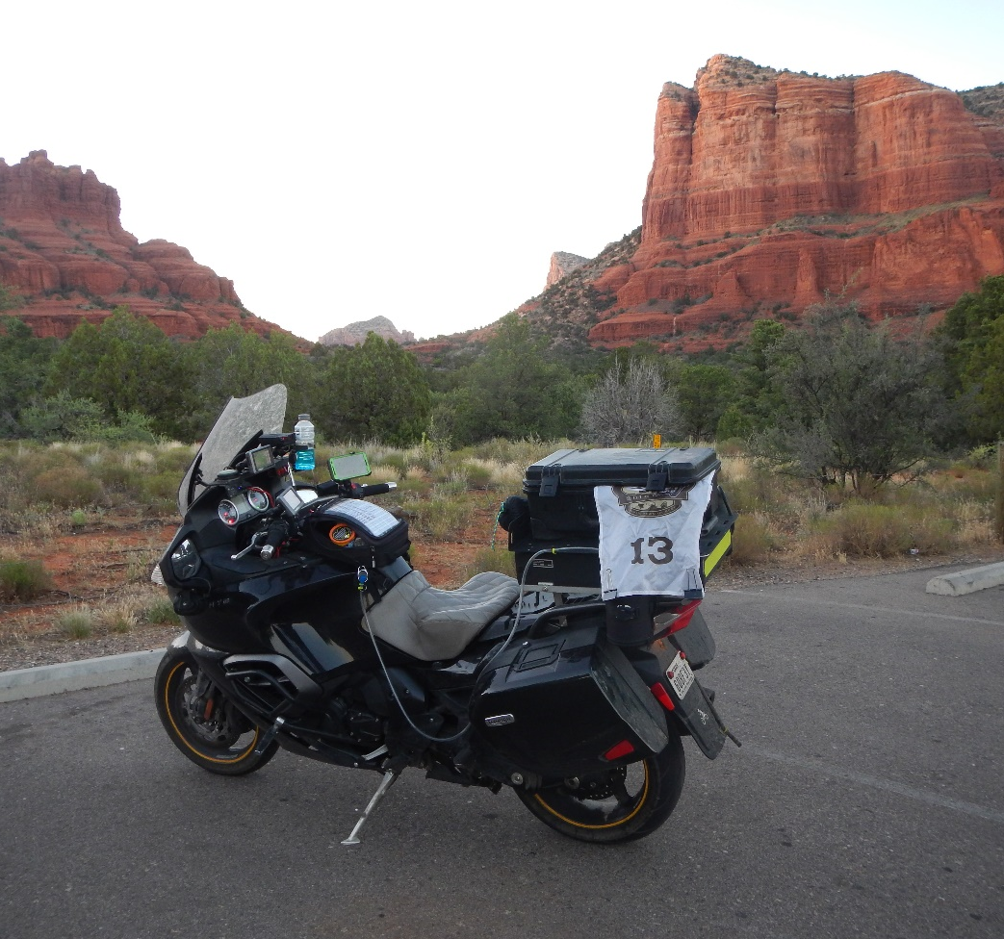
RALLY
101
Your first motorcycle bonus rally
Beginner clinic

Slide 2
Today’s path
THE RIDE
Plan your ride and ride your plan
Build a route that fits your real pace
Control stops and preserve a return cushion
02

Slide 3
Today’s path
THE RIDER
Eat, drink, and sleep
Know your gear and motorcycle
Practice the complete routine before rally day
03

Slide 4
How a bonus rally works
01
Read
The organizer supplies the rules, bonus list, and finish requirements.
02
Choose
You select a manageable group of locations and decide their order.
03
Ride
You complete each task and preserve the required evidence.
04
Return
You meet the deadline, check in, and submit valid claims.
04

Slide 5
A good first rally
Finish safely, on time, and wanting to do another one
A modest score with valid claims teaches more than an ambitious route that falls apart.
06

Slide 6
Rally riding and certification rides
CERTIFICATION RIDE
Usually follows a defined mileage or route requirement
Often relies heavily on major roads and fuel receipts
Requires relatively little route adjustment during the ride
07

Slide 7
Rally riding and certification rides
BONUS RALLY
Adds off-route stops, urban delays, and task requirements
Forces choices about points, time, access, and the finish
Rewards judgment more than raw mileage
08

Slide 8
Your sustainable rally pace
45–55
Count every minute, including bonuses, fuel, food, traffic, and rest
Use your own history, not someone else’s moving average
Short rallies can be slower because the stops are closer together
overall miles per hour
09

Slide 9
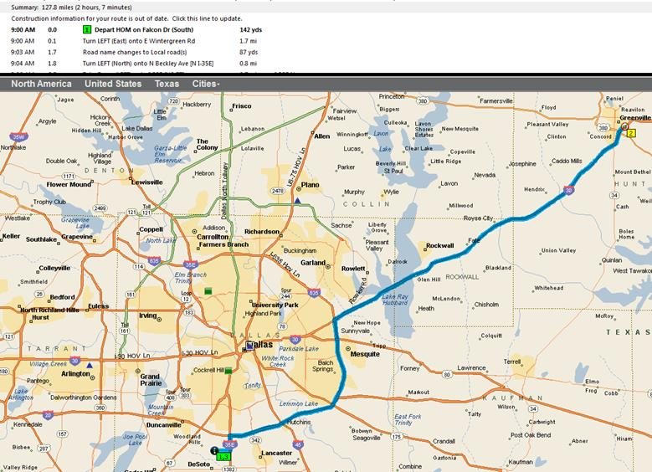
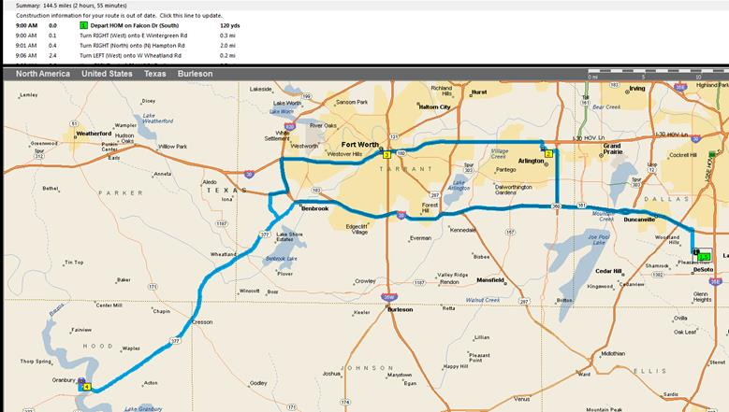
One distant bonus or three closer stops?
102 points
121 points
10
Notes:
Original clinic comparison: Audie Murphy versus the Jesse James, Peters Brothers Hats, and Fallen Fan combination. Discuss stop count, road type, traffic, and the value of simplicity.

Slide 10
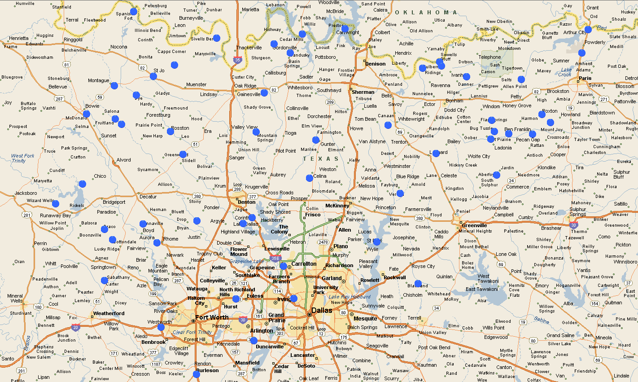
The best route fits the entire day
Compare points with total travel time and time off the motorcycle
Fewer stops can outperform a higher point-per-mile cluster
11

Slide 11
The best route fits the entire day
Know which optional stop you will drop first
Choose a route home before you need it
12

Slide 12
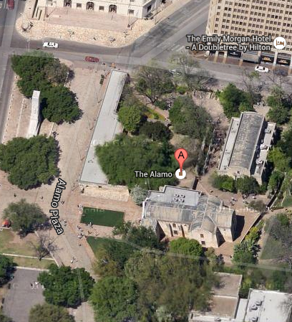
Know the whole bonus field
Review every location, not only the stops in your first plan
Confirm coordinates, access, parking, and time restrictions
13

Slide 13
Know the whole bonus field
Use map imagery to understand the last hundred yards
Keep alternate bonuses available for weather, traffic, or closures
14

Slide 14
The plan will change
A useful plan leaves room to change it
Traffic, weather, fatigue, amended bonuses, and access problems can all change the correct route.
15

Slide 15
RIDER MANAGEMENT
Eat, drink, and sleep
The motorcycle can keep running after the rider should stop.
16

Slide 16
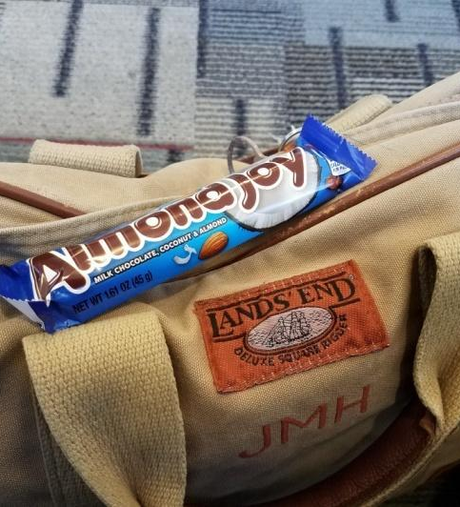
Food and water
Carry water and food you already know your body tolerates
Eat small amounts regularly instead of waiting for a full meal stop….but don’t disregard the opportunity for a full meal stop
17

Slide 17
Food and water
Favor familiar snacks over heavy food and concentrated sugar
Plan bathroom and replenishment stops into the route
18

Slide 18
Fatigue changes the plan
Sleepiness means it is time to stop
Get completely off the roadway. Rest, reassess, and tell rally staff when the event requires it.
19

Slide 19
Naps and real sleep
SHORT RESET
A brief nap can restore alertness for a limited period
Allow time to wake fully before riding again
Use a safe, legal place away from traffic
20
Notes:
The original clinic discussed roughly 20-minute power naps and 90-minute-to-two-hour sleep periods. Present these as practical examples, not medical guarantees.

Slide 20
Naps and real sleep
MEANINGFUL REST
Longer sleep addresses the debt created by extended riding
A hotel plan needs a backup when the route changes
No bonus replaces safe sleep
21
Notes:
The original clinic discussed roughly 20-minute power naps and 90-minute-to-two-hour sleep periods. Present these as practical examples, not medical guarantees.

Slide 21
TIME MANAGEMENT
Stops decide your average
Gas, food, hotels, and bonuses all consume rally time.
22

Slide 22
A stop plan
ROUTINE STOPS
Choose fuel stations with reliable hours and usable receipts
Carry food that reduces extra shopping and meal stops
Pack hotel items so one bag goes inside with you
23

Slide 23
A stop plan
BONUS STOPS
Park safely and secure the motorcycle
  (don’t drop your bike)
Read the task before taking the photograph
Check the evidence, record the claim, and reset your gear
24

Slide 24
The speedometer does not show the day’s average
120 miles ÷ 4 hours
30 mph overall
Three hours riding at 40 mph plus one hour stopped still uses four hours of rally time.
25

Slide 25
The return-time decision
The last optional stop is still optional
Protect the finish deadline with a real cushion. Traffic, fuel, and a wrong turn can consume it quickly.
26

Slide 26
A repeatable bonus routine
01
Park
Choose a safe place, secure the motorcycle, and take the rally book with you.
02
Read
Confirm the exact target, required view, rider number, and any restriction.
27

Slide 27
A repeatable bonus routine
03
Capture
Take the photograph, then check focus, glare, framing, and required details.
04
Record
Log the claim, put the flag and camera back in their usual places, then leave.
28

Slide 28

The rally book is the task list
The map pin does not contain the full instruction
Match the bonus code, task wording, reference image, and access warning
29

Slide 29
The rally book is the task list
Read amendments before building or changing the route
Resolve conflicting information with the rally organizer
30

Slide 30
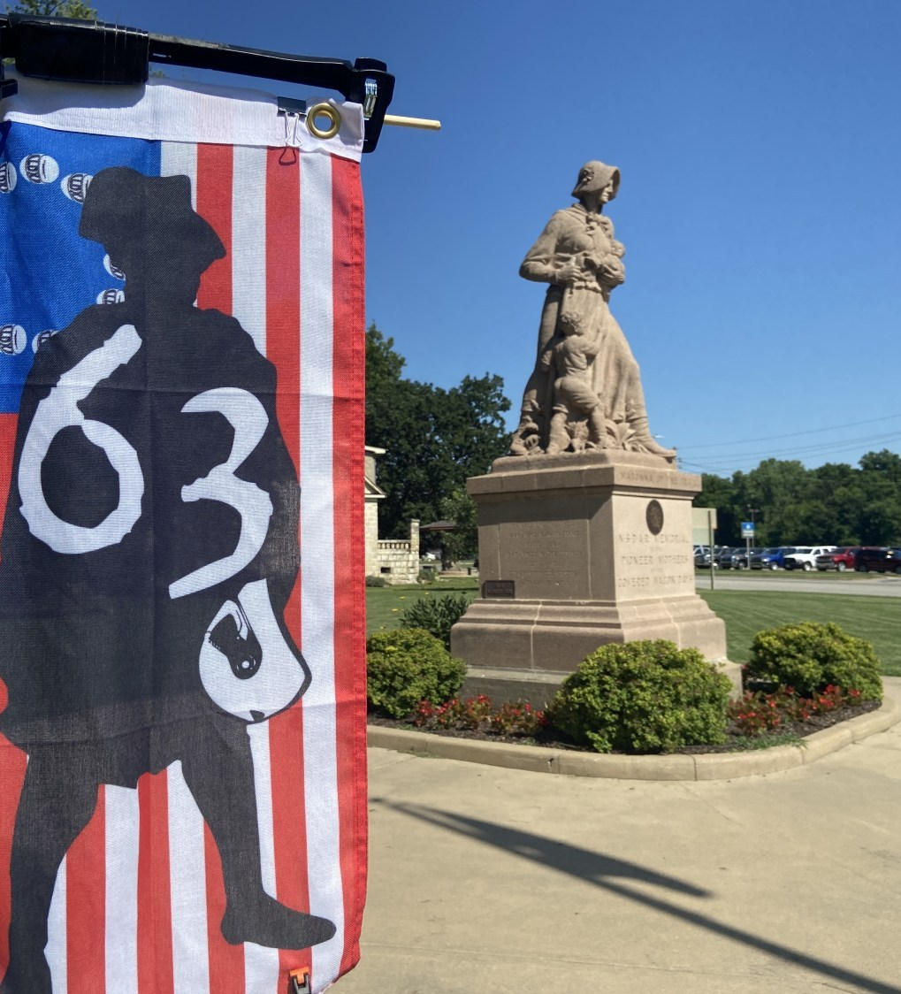
A valid photo and claim
Show the correct target and the required rider number or flag
Keep the full required object visible
31

Slide 31
A valid photo and claim
Record the code, time, odometer, receipt, or other required evidence
Check electronic submission confirmation before moving on
32

Slide 32
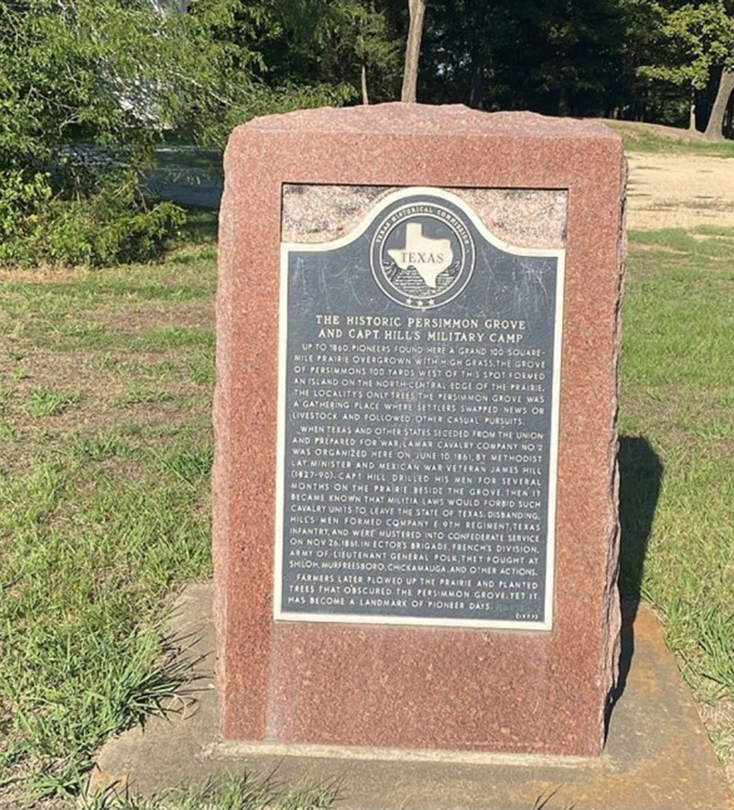
Practice one complete bonus
The goal is a routine you can repeat under pressure
Read the task aloud before approaching the target
Choose a safe place for the motorcycle
33

Slide 33
MOTORCYCLE AND EQUIPMENT
Know your gear
Use equipment you understand before adding equipment you merely own.
35

Slide 34
The equipment you need
STARTING SETUP
Reliable motorcycle and protective riding gear
Allowed camera or phone with dependable power
Navigation method you can operate while parked
Flag, rally book, claim method, and required documents
36

Slide 35
The equipment you need
ADD ONLY WHEN NEEDED
Extra navigation or camera equipment
Specialized long-distance accessories
Additional luggage or auxiliary systems
Anything the event rules specifically require
37

Slide 36
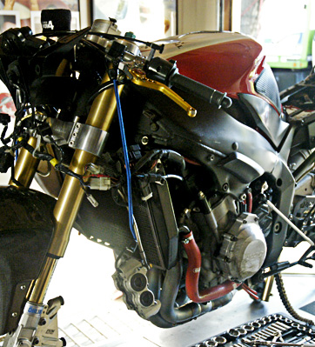
Motorcycle check
Service early enough to ride and test the result
Inspect tires, controls, lights, fluids, chassis, and stands
38

Slide 37
Motorcycle check
Check charging cables, mounts, auxiliary fuel lines, and luggage
Start with fresh consumables appropriate for the rally distance
39

Slide 38
Breakdowns and packing
BREAKDOWN PLAN
Tire repair method and air source you have already tested
Tools for repairs you can actually perform
Roadside, towing, medical, and emergency contact information
40

Slide 39
Breakdowns and packing
PACKING PLAN
Rain protection, temperature layers, and spare gloves
Dry clothing, medication, documents, money, and a spare key
One consistent place for every rally-critical item
41

Slide 40
Weather and road attention
WHILE MOVING
Scan ahead and keep an escape option
Adjust speed to visibility, traction, and fatigue
Keep stopping distance inside the road you can see at night
42

Slide 41
Weather and road attention
WHILE PARKED
Read the rally book and revise the route
Enter coordinates and answer messages
Check weather, photographs, and return time
43

Slide 42
REHEARSAL
Practice before rally day
The first time you use the complete system should not be during the event.
44

Slide 43
Four files, four jobs
RALLY INFORMATION
PDF: rules, tasks, warnings, and reference photos
Spreadsheet: sortable bonus details and consistent codes
45
Notes:
A KMZ is a compressed KML package. File extension and file contents are different things.

Slide 44
Four files, four jobs
MAP DATA
GPX: waypoints, routes, or tracks for compatible tools
KML or KMZ: geographic information for map applications
46
Notes:
A KMZ is a compressed KML package. File extension and file contents are different things.

Slide 45
Coordinates: the sign matters
33.682414, -95.817325
Latitude first. Longitude second.
North Texas needs the negative longitude. One missing minus sign can move a waypoint across the world.
47

Slide 46
GPS transfer: the complete test
01
Import
Load the practice GPX into compatible software or the documented device folder.
02
Inspect
Find a known waypoint and confirm its coordinates and expected location.
48
Notes:
BaseCamp compatibility varies by Garmin model. zūmo XT and XT2 support documented GPX-folder transfer. Confirm the exact device and software before class.

Slide 47
GPS transfer: the complete test
03
Transfer
Send only the intended list, using a data-capable cable or supported workflow.
04
Verify
Open the data on the actual GPS and preview navigation while parked.
49
Notes:
BaseCamp compatibility varies by Garmin model. zūmo XT and XT2 support documented GPX-folder transfer. Confirm the exact device and software before class.

Slide 48
Google My Maps: planning view
01
Create
Open My Maps in a computer browser and create a named practice map.
02
Import
Load the clinic KML, KMZ, or GPX into a reference layer.
50
Notes:
My Maps is a planning tool. A straight drawn line is not a road route, and a Google map does not automatically load a Garmin.

Slide 49
Google My Maps: planning view
03
Explore
Inspect individual bonuses, access, imagery, and a small group of possible stops.
04
Compare
Use a directions layer to compare a road path with the available time.
51
Notes:
My Maps is a planning tool. A straight drawn line is not a road route, and a Google map does not automatically load a Garmin.

Slide 50
When an import appears to fail
SYMPTOM
The device only charges
No route appears
Points appear far away
The route changes after transfer
52

Slide 51
When an import appears to fail
FIRST CHECK
Cable, USB port, transfer mode, and compatibility
The file may contain waypoints rather than a route
Coordinate format, minus sign, and source file
Maps, avoidances, vehicle profile, and recalculation
53

Slide 52
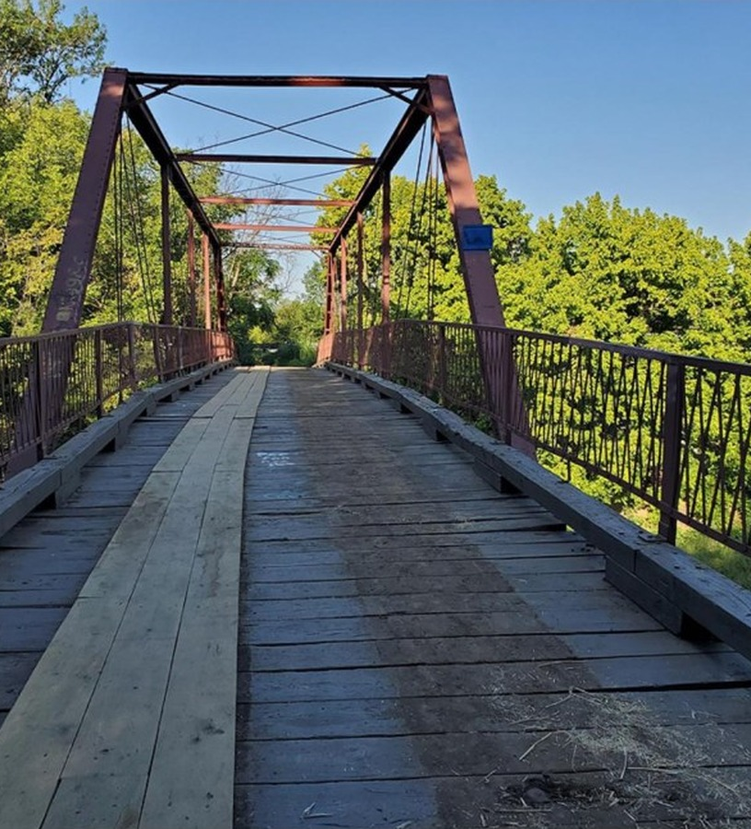
Hands-on practice
Imported. Found. Verified.
Import one practice file
Find one known bonus and verify its code and coordinates
54

Slide 53
Hands-on practice
Confirm three saved points on the navigation device when available
Explain the next step in your own words
55

Slide 54
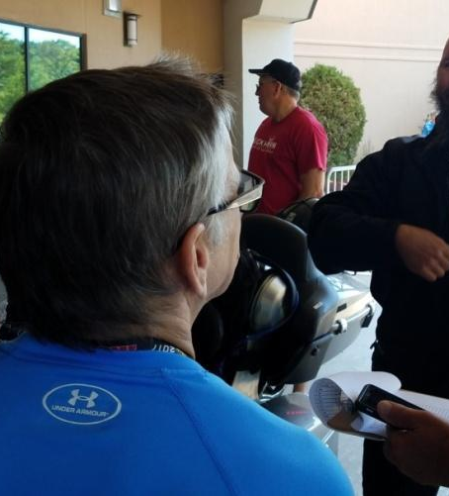
Before the start and at the finish
Start rested, equipped, and clear on the current rules
Know the finish location, deadline, and what officially stops the clock
56

Slide 55
Before the start and at the finish
Check in before organizing or presenting claims
Record one lesson while it is still fresh
57

Slide 56
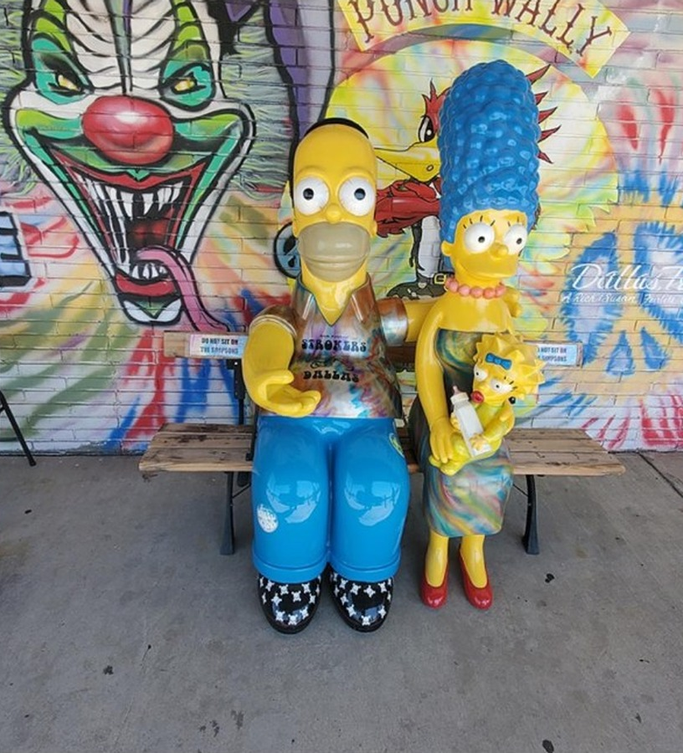
Your first practice ride
Choose two or three familiar public locations
Use the same navigation, camera, flag, and storage routine
58

Slide 57
Your first practice ride
Measure the entire outing, including every stop
Change one part of the process before the next ride
59

Slide 58
The core lesson
Choose less. Execute it well. Return with time to spare.
A successful first rally combines a realistic route, a repeatable stop routine, and the judgment to change the plan.
60

Slide 59
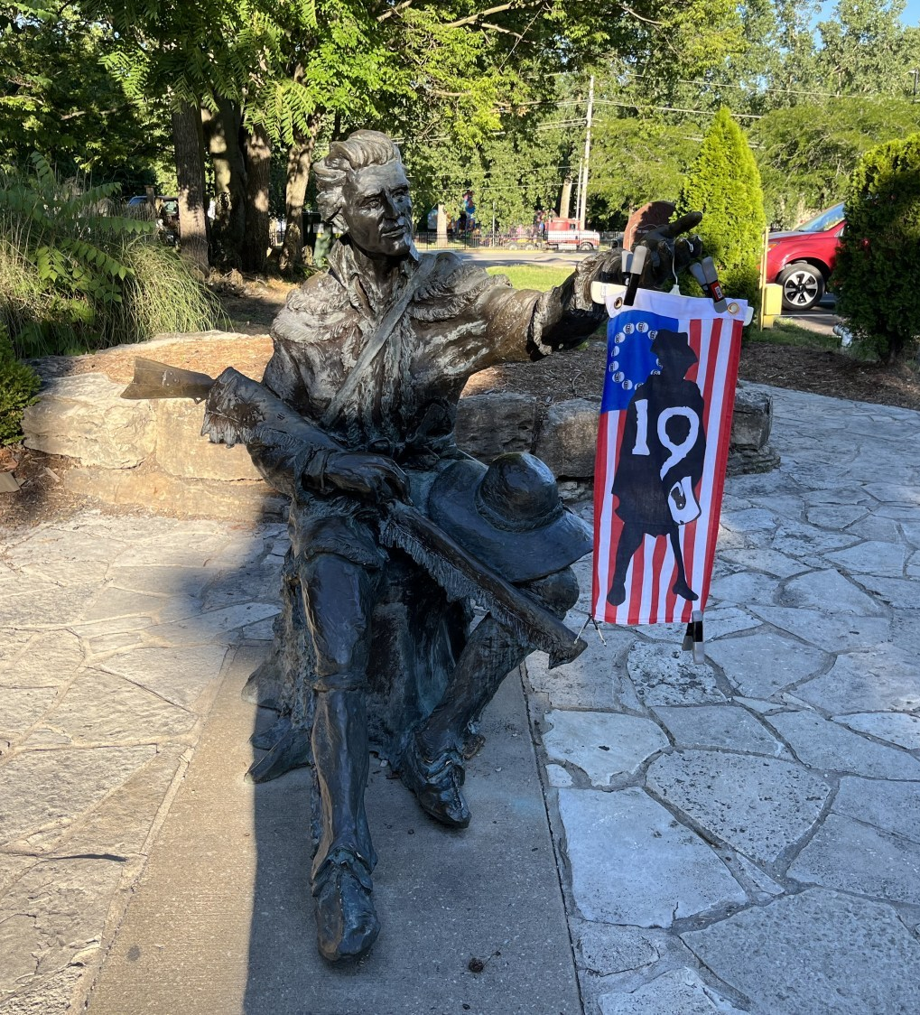
Photo and claim checklist
Correct bonus, side, view, and required objects
Readable rider number or rally flag
REFERENCE 61

Slide 60
Photo and claim checklist
Focus, exposure, and framing checked before departure
Code, time, odometer, receipt, and submission recorded as required
REFERENCE 62

Slide 61
Personal packing checklist
RIDER AND WEATHER
Helmet, eye protection, jacket, pants, gloves, and boots
Rain protection and temperature layers
Water, familiar food, medication, and dry clothing
REFERENCE 63

Slide 62
Personal packing checklist
BIKE AND DOCUMENTS
License, insurance, contacts, money, and spare key
Navigation, camera, tested cables, flag, and claim method
Tire plan, suitable tools, and secure luggage
REFERENCE 64

Slide 63
Sample claim record
CODE
TIME
ODOMETER
EVIDENCE
POINTS
BC19
10:42
18,234 mi
Photo 017
39
BC29
11:38
18,270 mi
Photo 021
48
Use the event’s actual form and required units. Keep the record easy to match with the evidence.
REFERENCE 65

Slide 64
Reference: BaseCamp workflow
01
Create a list
Use a dedicated list for the rally or clinic practice file.
02
Import
Choose File, Import, then open the downloaded GPX.
REFERENCE 66

Slide 65
Reference: BaseCamp workflow
03
Inspect
Confirm a known waypoint, the expected point count, and recognizable names.
04
Send
Select the list, send it to a compatible device, then verify on that device.
REFERENCE 67

Slide 66
Reference: USB copy and verification
01
Connect
Use a data-capable cable and the device’s documented transfer mode.
02
Copy
Place the GPX in the folder specified by that model’s manual.
REFERENCE 68

Slide 67
Reference: USB copy and verification
03
Disconnect
Wait for copying to finish and eject when the operating system offers it.
04
Verify
Find known saved locations and preview navigation while parked.
REFERENCE 69

Slide 68
Google My Maps reference
01
New map
Create and name a map in a computer browser.
02
Reference layer
Import the original KML, KMZ, or GPX without changing the source data.
REFERENCE 70

Slide 69
Google My Maps reference
03
Practice layer
Add notes or selected stops separately from the original data.
04
Directions
Compare a short road path with the rally time budget.
REFERENCE 71

Slide 70
Instructor run sheet
CORE LESSON
Rally basics and route judgment
Rider needs, fatigue, and stop discipline
Bonus routine, valid evidence, and gear
REFERENCE 72
Notes:
Suggested live sequence: about 90 minutes for the core lesson, a break, then demonstrations and practice. Adjust to the class and available equipment.

Slide 71
Instructor run sheet
PRACTICE AND DEMO
File types and navigation transfer
One complete bonus exercise
Before-start and finish review
REFERENCE 73
Notes:
Suggested live sequence: about 90 minutes for the core lesson, a break, then demonstrations and practice. Adjust to the class and available equipment.

Slide 72
Sources and class materials
RIDING AND SAFETY
Motorcycle Safety Foundation operator material and T-CLOCS checklist
NHTSA drowsy-driving guidance
Motorcycle and equipment manuals
REFERENCE 74

Slide 73
Sources and class materials
RALLY AND NAVIGATION
Original Rally Clinic Powerpoint supplied by the presenter
Rally 101 clinic files and archive photographs
Garmin BaseCamp, device manuals, and Google My Maps documentation
REFERENCE 75

